Slide 1
Tree Diversity in Berkeley
By: Rosetta Wang, Kamal Bains, Omeed Tavasoli

Slide 2
Motivating Example
An article within the Journal of Urban Ecology investigated the social-ecological and demographic dynamics of urban foraging in the USA
Foraging- a potentially critical element of food security because of its ability to support social cohesion, food justice, and ecosystem restoration
Utilized user-generated data from the community-based monitoring application Falling Fruit (fallingfruit.org).

Slide 3
Article Key Result
Our Inspired Purpose
The main article result indicated high ethnic diversity in gathering communities and that the demographic variability of gathering communities implies a range of drivers motivating urban foraging—from sustenance to recreation
Interested in uncovering the degree of ecological tree diversity in Berkeley
Higher diversity is correlated to greater ecological community health
A lower diversity could reflect a higher degree of uniform ornamental planting
Notes:
Census track data, ethnic profiles,

Slide 4
Network
We chose to use this same Falling Fruit network to source data on flora, particularly trees within Berkeley
The network included a dataset gathered/compiled from the City of Berkeley that catalogs the city’s trees

Slide 5
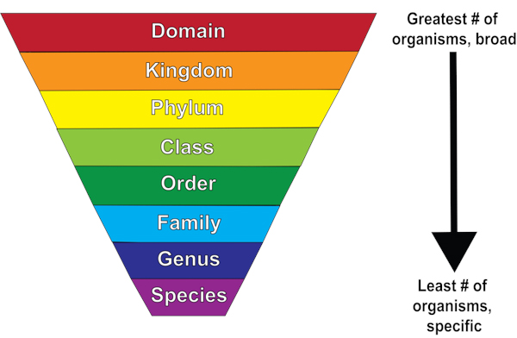
Data Set Filtering Process
Taxonomy
Genus - first in name
Species- last in name
Latitude
Longitude
Notes:
Would scrape for higher classifications for a better understanding of ecological diversity for future research

Slide 6
Network
uncleaned
the_geom | SiteID | STRT_NUM | STRT_NAM | STRT_ASSIG | BLOCK_ON | SPECIES | ITREE | Common_Nam | OTHER_TREE | ... | CURB | GUARD | SPACESIZE | TREESIZE | GPS_Date | Vert_Prec | Horz_Prec | Latitude | Longitude | AreaID
0 | POINT (-122.27825103970729 37.8849535051094) | 19143 | 1161 | COLUSA AVE | N | BEVERLY PL | Prunus cerasifera | PRCE | Cherry plum | NaN | ... | Y | N | 3.5 | NaN | 10/01/2012 07:00:00 AM +0000 | 0.1 | 0.1 | 37.884954 | -122.278251
cleaned
id | Latitude | Longitude | genus | species
0 | 37.884954 | -122.278251 | Prunus | cerasifera

Slide 7
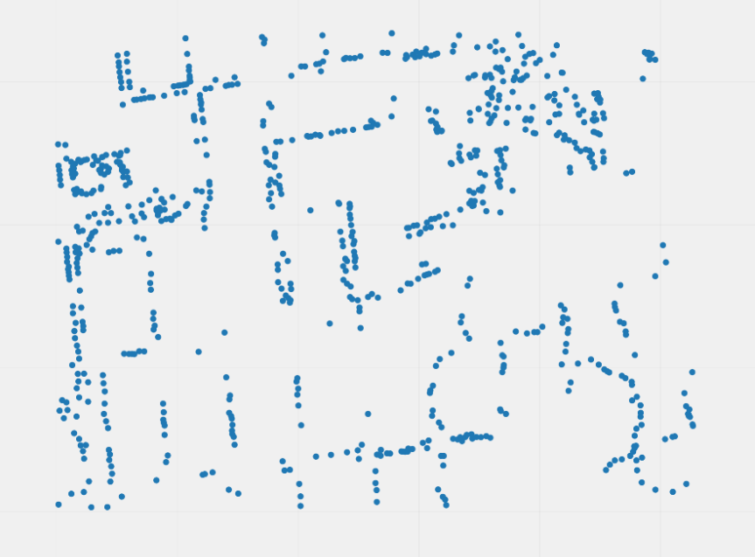
Nodes
individual plants
Notes:
Rosetta

Slide 8
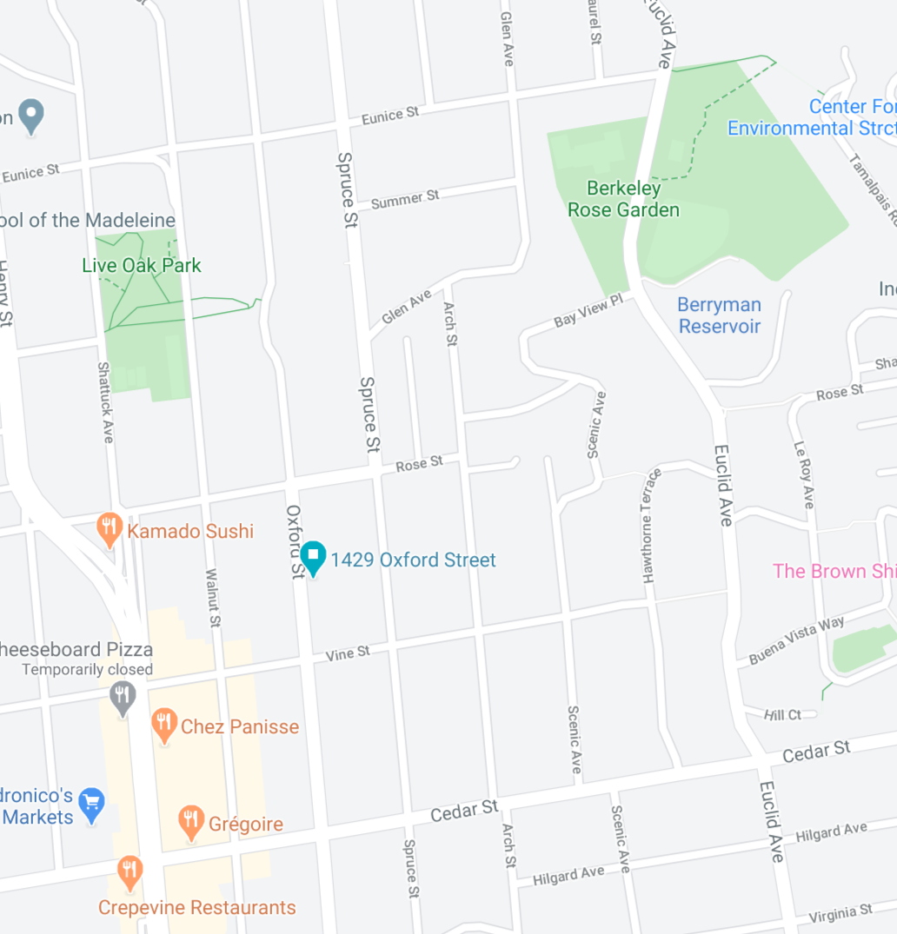
Solution
More premium subscribers
Notes:
Rosetta

Slide 9
1 km²
Cleaned by longitude/ latitude
Notes:
Rosetta

Slide 10
Weight Schema
inner threshold: 25 meters
outer thresholds: 50 meters
 | Below inner threshold | Between inner and outer thresholds
Different genus and species | 4 | 3
Same genus, different species | 2 | 1
Notes:
Rosetta

Slide 11
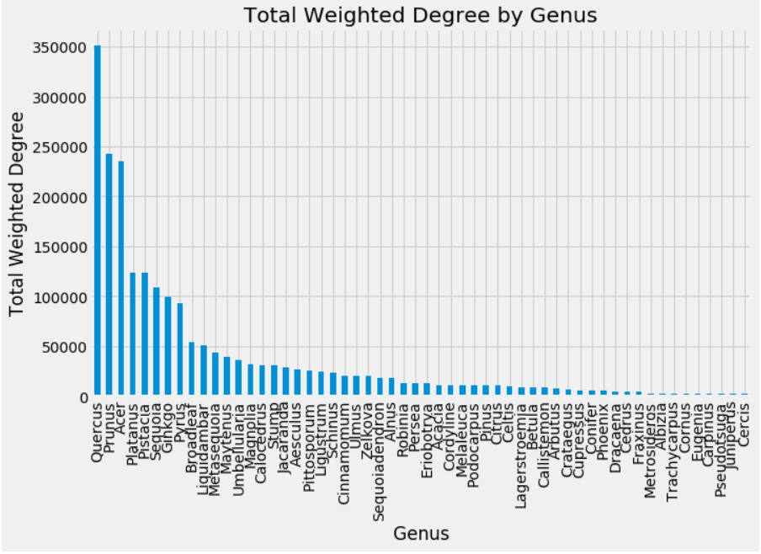
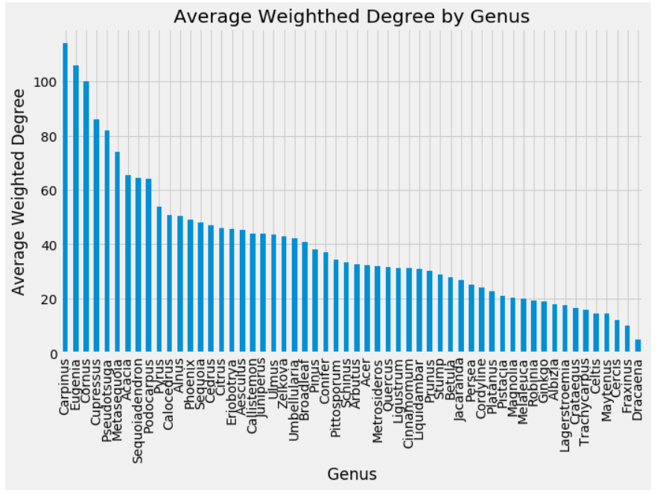
Notes:
Omeed

Slide 12
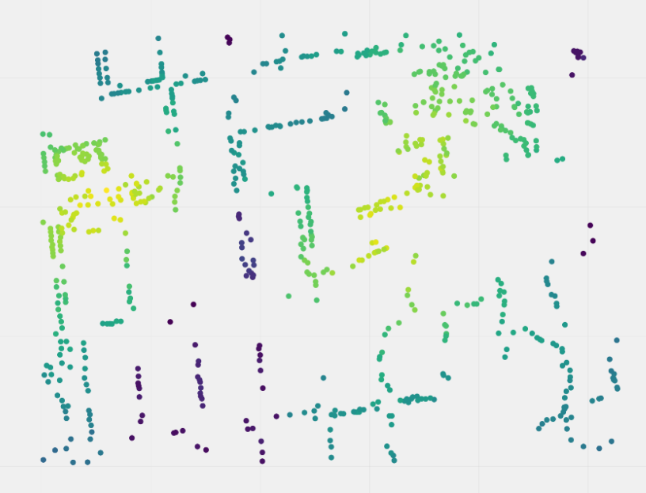
More premium subscribers
Notes:
Rosetta

Slide 13
Key Results
Conclusions
Our analysis of the weighted degree of the nodes show that although few genuses have many connections, they do not significantly add to the ecological diversity of Berkeley
The closeness centrality measure also shows that certain hotspots of ecological diversity exist in Berkeley
Coincide with Live Oak Park and the Rose garden
Berkeley, like many other urban areas, is not ecologically diverse. Although we cannot make any causal claims, our analysis shows that few genuses dominate much of the area and that aside from intentionally planned areas like Live Oak Park and the Rose Garden, we see a steep decline in ecological diversity.
Notes:
Census track data, ethnic profiles,

Slide 14
Extensions
Steps for the future would be to expand the area of assessment as well as flesh out a more rigorous and theoretically based metric for measuring diversity. Moreover, we could consider census tract areas to assess whether there is correlation between between socio-economic groups and ecological diversity
Expanding the data set to include other plants genuses
Expanding the Locality
Analyzing socio-economic correlations with ecological diversity
Notes:
Rosetta

